Slide 1
Day 4

Slide 2

Case Study 1: Get all employee detail from Employee Detail table whose "FirstName" start with any single character between 'a-p'

Slide 3
Solution: Get all employee detail from EmployeeDetail table whose "FirstName" start with any single character between 'a-p'
ANS: MS SQL Server: SELECT * FROM EmployeeDetail WHERE FirstName like ‘[a-p]%’

Slide 4
Get all employee detail from Employee. Detail table whose "FirstName" not start with any single character between 'a-p’
Case Study 2:

Slide 5
Get all employee detail from EmployeeDetail table whose "FirstName" not start with any single character between 'a-p’
Case Study 2:

Slide 6
Find all users with first names not ending with letters between n–s.
Case Study 3:

Slide 7
Find all users with first names not ending with letters between n–s.
Solution
SELECT * FROM users WHERE first_name LIKE ‘%[^n-s]'

Slide 8
Create table First:
-- Create the Product table with the StateProvinceCode column
CREATE TABLE Product (
ProductID INT PRIMARY KEY,
ProductNumber VARCHAR(10),
StateProvinceCode VARCHAR(2) -- Add the StateProvinceCode column
);
-- Insert 10 random values into the table
INSERT INTO Product (ProductID, ProductNumber, StateProvinceCode)
VALUES
(1, 'LA-123', 'CA'),
(2, 'LB-456', 'NY'),
(3, 'LC-789', 'TX'),
(4, 'LD-135', 'FL'),
(5, 'LE-246', 'CA'),
(6, 'LF-357', 'NY'),
(7, 'LG-999', 'TX'),
(8, 'LH-123', 'FL'),
(9, 'LI-456', 'CA'),
(10, 'LJ-789', 'NY'),
(11, 'LK-246', 'TX'),
(12, 'LL-357', 'FL'),
(13, 'LM-999', 'CA'),
(14, 'LN-123', 'NY'),
(15, 'LO-456', 'TX'),
(16, 'LP-789', 'FL'),
(17, 'LQ-135', 'CA'),
(18, 'LR-246', 'NY'),
(19, 'LS-357', 'TX'),
(20, 'LT-999', 'FL');
-- Insert 10 random values into the table
INSERT INTO Product (ProductID, ProductNumber, StateProvinceCode)
VALUES
(11, 'LK-246', 'TX'),
(12, 'LL-357', 'FL'),
(13, 'LM-999', 'CA'),
(14, 'LN-123', 'NY'),
(15, 'LO-456', 'TX'),
(16, 'LP-789', 'FL'),
(17, 'LQ-135', 'CA'),
(18, 'LR-246', 'NY'),
(19, 'LS-357', 'TX'),
(20, 'LT-999', 'FL');

Slide 9
Create table First:
CREATE TABLE Location (
LocationID INT PRIMARY KEY,
StateProvinceCode VARCHAR(2),
City VARCHAR(50),
ZipCode VARCHAR(10)
);
INSERT INTO Location (LocationID, StateProvinceCode, City, ZipCode)
VALUES
(12, 'CP', 'Los Angeles', '90001'),
(23, 'NP', 'New York', '10001'),
(34, 'TC', 'Houston', '77001'),
(45, 'FK', 'Miami', '33101'),
(57, 'IO', 'Chicago', '60601'),
(68, 'WA', 'Seattle', '98101'),
(71, 'MI', 'Boston', '02101'),
(82, 'GW', 'Atlanta', '30301'),
(93, 'CQ', 'Denver', '80201'),
(101, 'AC', 'Phoenix', '85001');

Slide 10
-- INNER JOIN
SELECT *
FROM Product
INNER JOIN Location ON Product.StateProvinceCode = Location.StateProvinceCode;
-- LEFT JOIN
SELECT *
FROM Product
LEFT JOIN Location ON Product.StateProvinceCode = Location.StateProvinceCode;
-- RIGHT JOIN
SELECT *
FROM Product
RIGHT JOIN Location ON Product.StateProvinceCode = Location.StateProvinceCode;
-- FULL OUTER JOIN
SELECT *
FROM Product
FULL OUTER JOIN Location ON Product.StateProvinceCode = Location.StateProvinceCode;
-- CROSS JOIN
SELECT *
FROM Product
CROSS JOIN Location;

Slide 11
String:
SELECT *
FROM StateProvince
WHERE StateProvinceCode LIKE 'A[BKL]';

Slide 12
String:
SELECT *
FROM Product
WHERE StateProvinceCode LIKE 'A[BKL]’;
In this pattern, 'A[BKL]', the [BKL] part represents a character class or character set, which means that it will match any single character that is either
'B', 'K', or 'L' after the letter 'A'. So, it will select rows where the StateProvinceCode starts with 'A' followed by either 'B', 'K', or 'L’.
StateProvinceCode | StateProvinceName
----------------- | -----------------
AB | Alberta
AK | Alaska
AL | Alabama
CA | California

Slide 13
String:
SELECT *
FROM Product
--WHERE ProductNumber LIKE 'L%';
WHERE ProductNumber LIKE 'L[A-Z]-[0-9]%'
SELECT *
FROM Product
--WHERE ProductNumber LIKE 'L%';
--WHERE ProductNumber LIKE 'L[A-Z]-[0-9]%'
WHERE ProductNumber LIKE 'L[I-N]-[135]%';

Slide 14
String:
SELECT CHARINDEX('D','DAD');
SELECT CHARINDEX('D','DAD',2);
SELECT ProductNumber
FROM Product
SELECT ProductNumber, CHARINDEX('I', ProductNumber)
FROM Product
SELECT ProductNumber, CHARINDEX('I', ProductNumber)
FROM Product
WHERE ProductNumber LIKE '%I%';

Slide 15
String:
SELECT ProductNumber, datalength(ProductNumber)
FROM Product
SELECT FORMAT(20200616,'####/##/##');

Slide 16
String:
SELECT ProductNumber, left(ProductNumber,2) AS ExtractNameFromLeft
FROM Product
SELECT ProductNumber, right(ProductNumber,2) AS ExtractNameFromRight
FROM Product
SELECT FirstName,LEN(FirstName) AS ExtractLengthOfName
FROM Person.Person;

Slide 17
String:
SELECT ProductNumber, datalength(ProductNumber) AS ExtractLength,
len(ProductNumber) AS ExtractLength_
FROM Product
DATALENGTH(ProductNumber) calculates the length of the ProductNumber column in bytes, including trailing spaces. This will give you the length of the data as it is stored in the database.
LEN(ProductNumber) calculates the length of the ProductNumber column in characters. It counts the number of characters in the string, excluding trailing spaces.
The difference between these two numbers for each row will be the number of trailing spaces in the ProductNumber column. If there are no trailing spaces, the two numbers will be the same.

Slide 18
String:
SELECT FirstName, LOWER(FirstName) AS LowerFName
FROM Person.Person;
SELECT FirstName, UPPER(FirstName) AS LowerFName
FROM Person.Person;
SELECT Ltrim(' Trim Left Side');
SELECT rtrim('Trim Left Side ');
SELECT trim(' Trim Both The Sides ');

Slide 19
String:
SELECT Name, PATINDEX('%Ball%',Name)
FROM Production.Product
WHERE Name LIKE '%Ball%';
SELECT Name, Patindex('%Cr_nk%',Name)
FROM Production.Product
WHERE Name LIKE '%Cr%';
SELECT LoginID, REPLACE(LoginID,'adventure-works','aw') AS ReplaceString
FROM HumanResources.Employee;
SELECT FirstName, REPLICATE(FirstName,3) AS ReplicateFName
FROM Person.Person;

Slide 20
String:
SELECT FirstName, REVERSE(FirstName) AS ReverseFName
FROM Person.Person;
SELECT Top 100 LastName, Substring(LastName,3,5) AS SubstringLName
FROM Person.Person
ORDER BY LastName;
SELECT ProductNumber,str(ProductID) AS ExtractNameFromRight
FROM Product --To convert into String

Slide 21
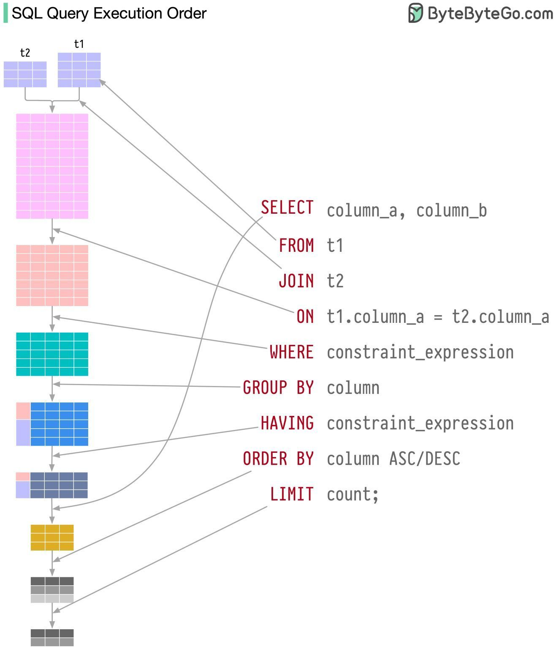

Slide 22
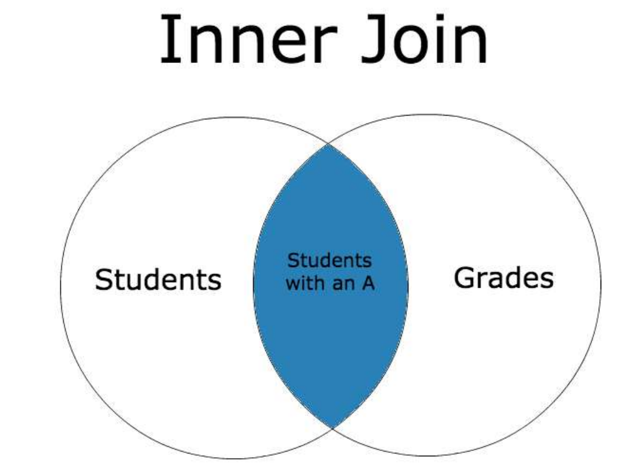

Slide 23
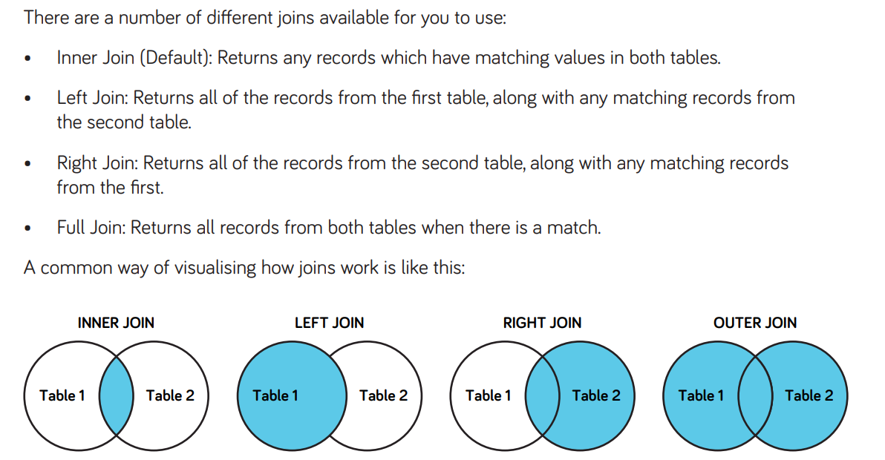

Slide 24
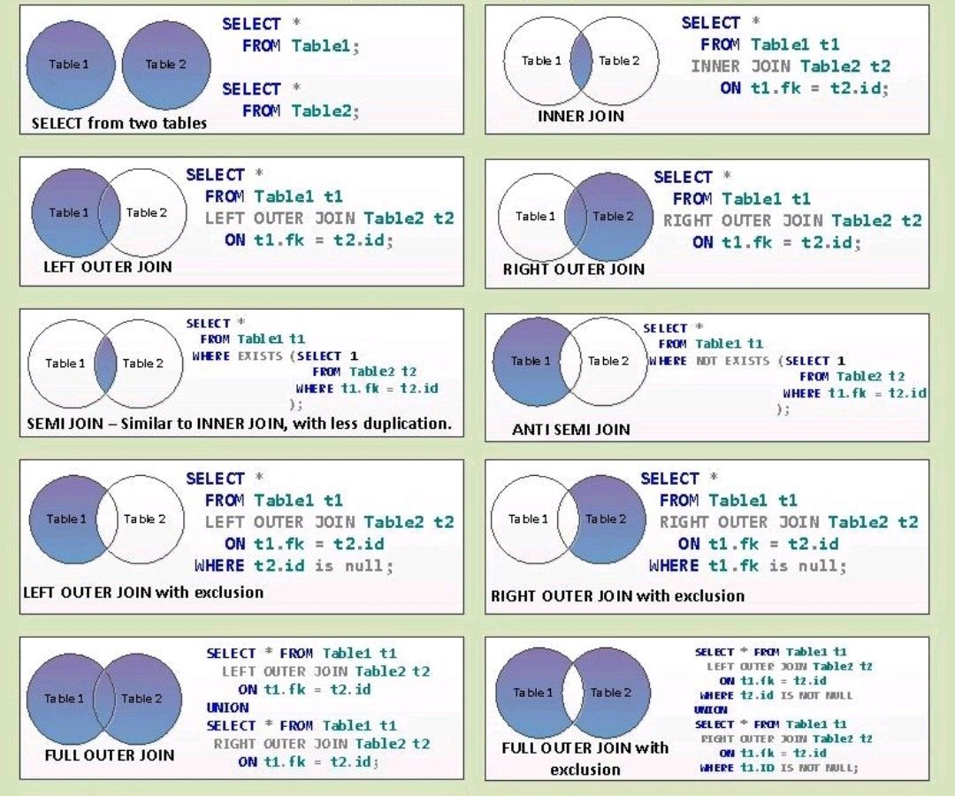

Slide 25


Slide 26
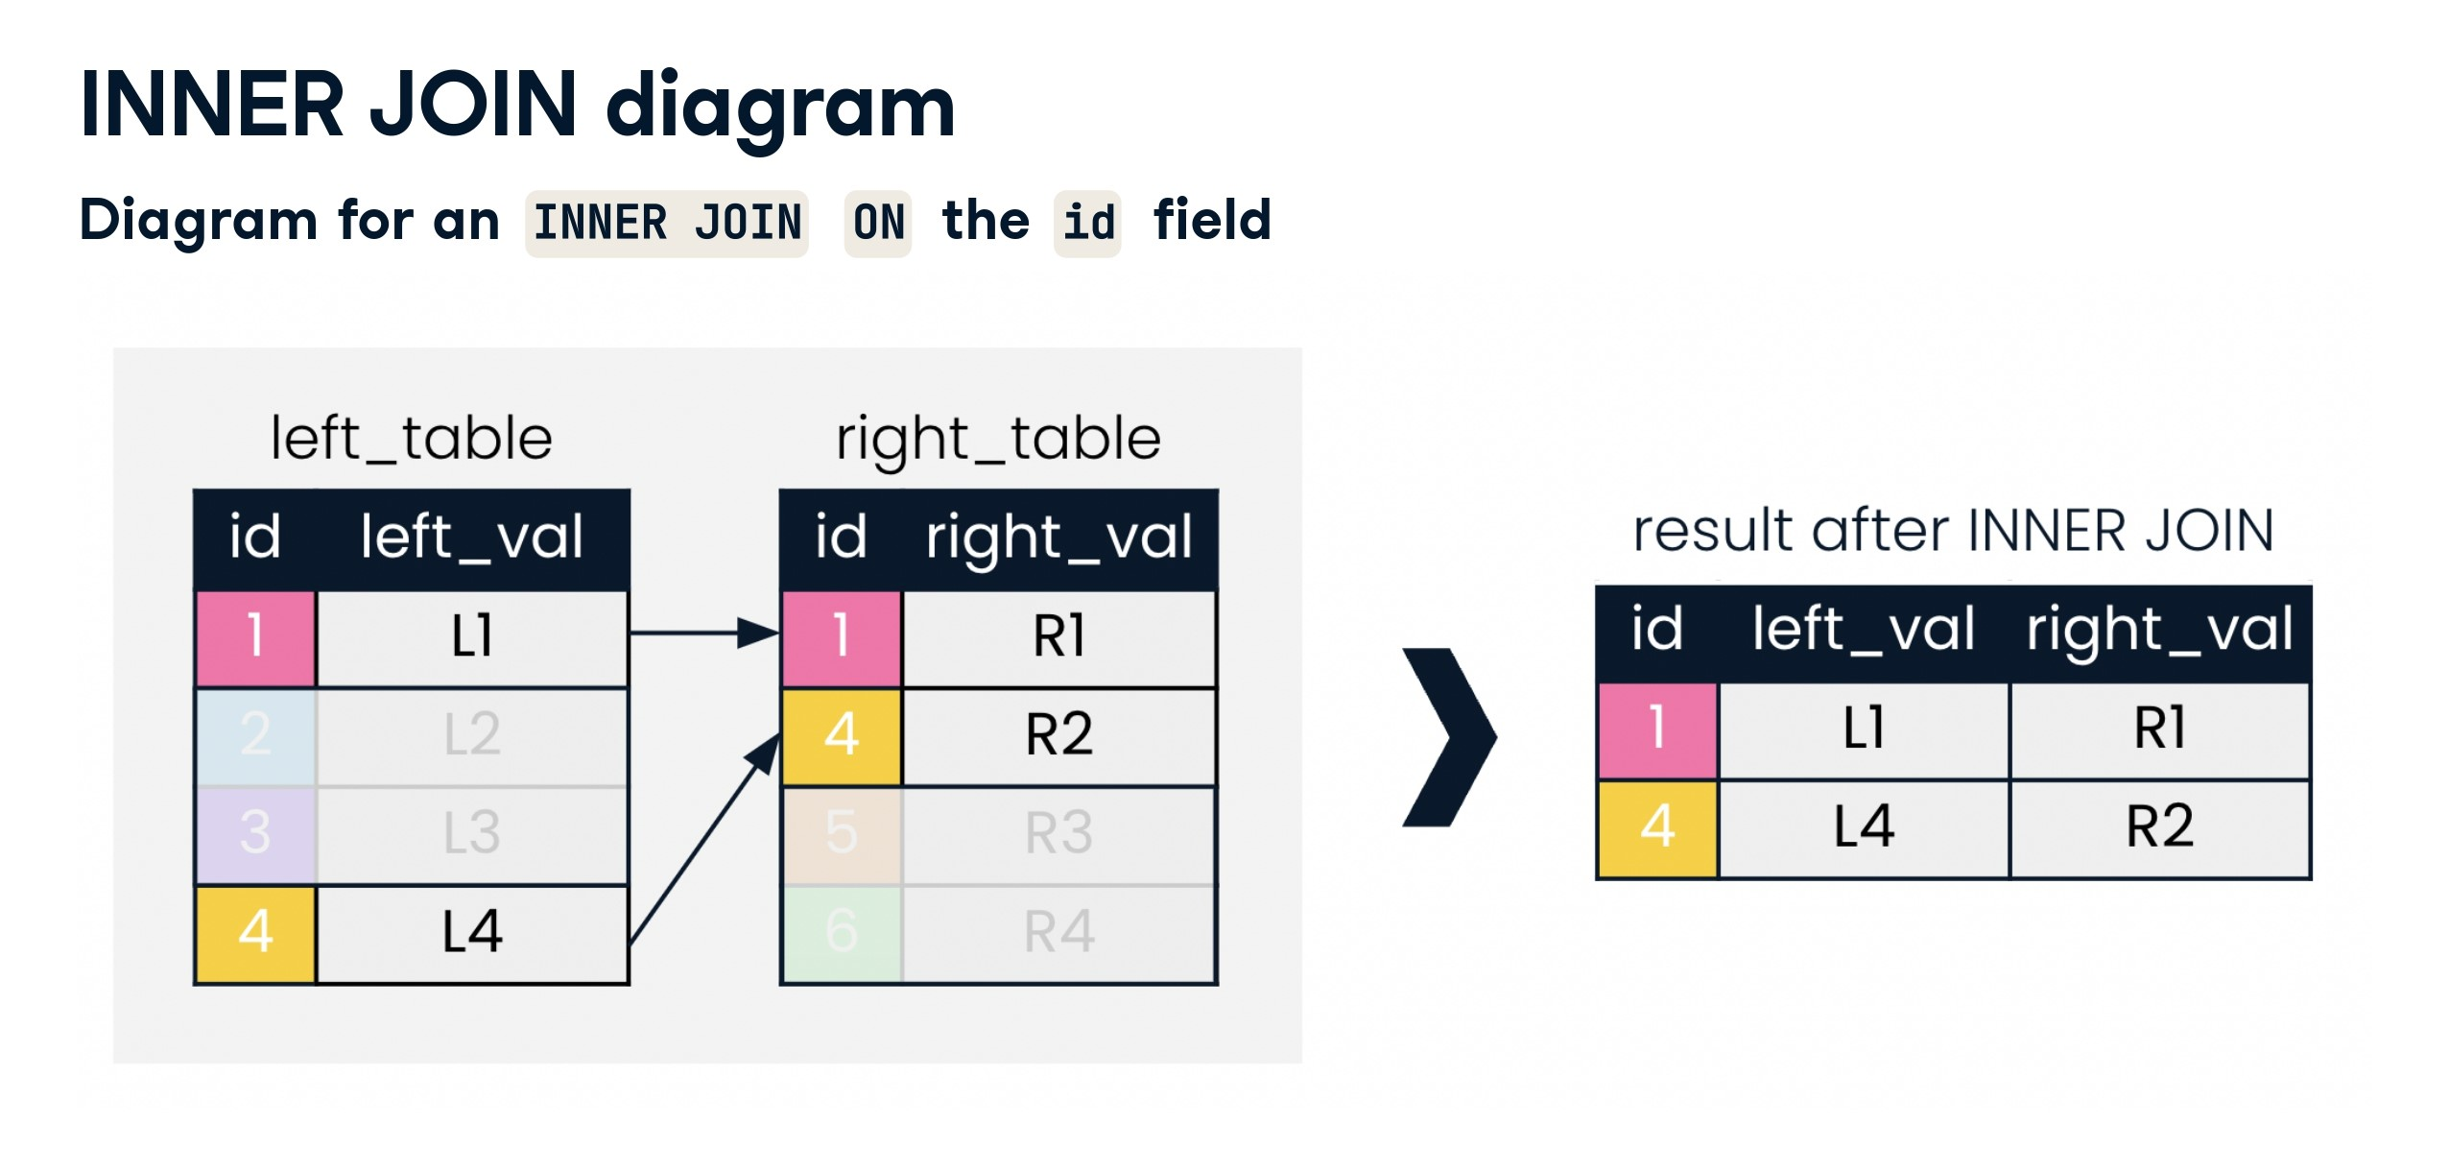

Slide 27
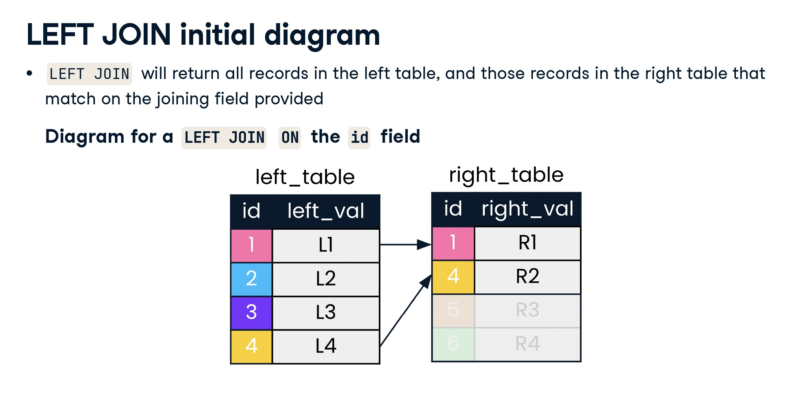

Slide 28
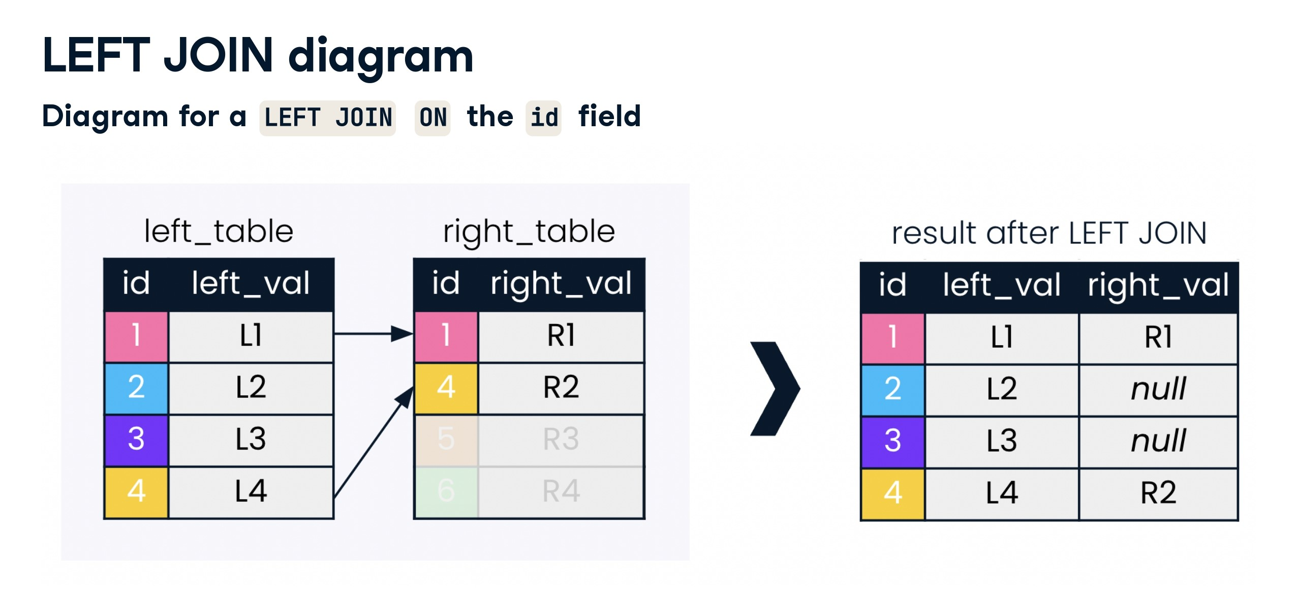

Slide 29
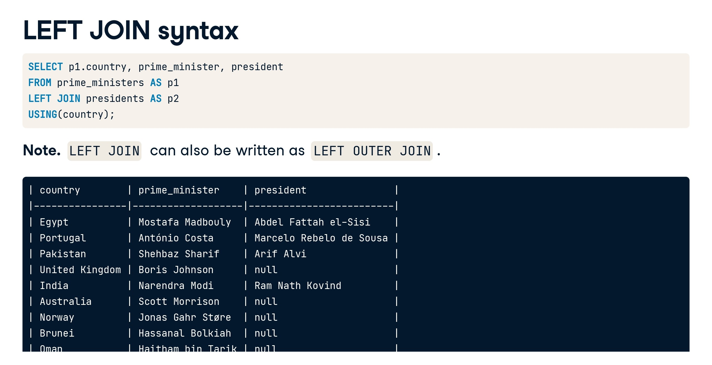

Slide 30
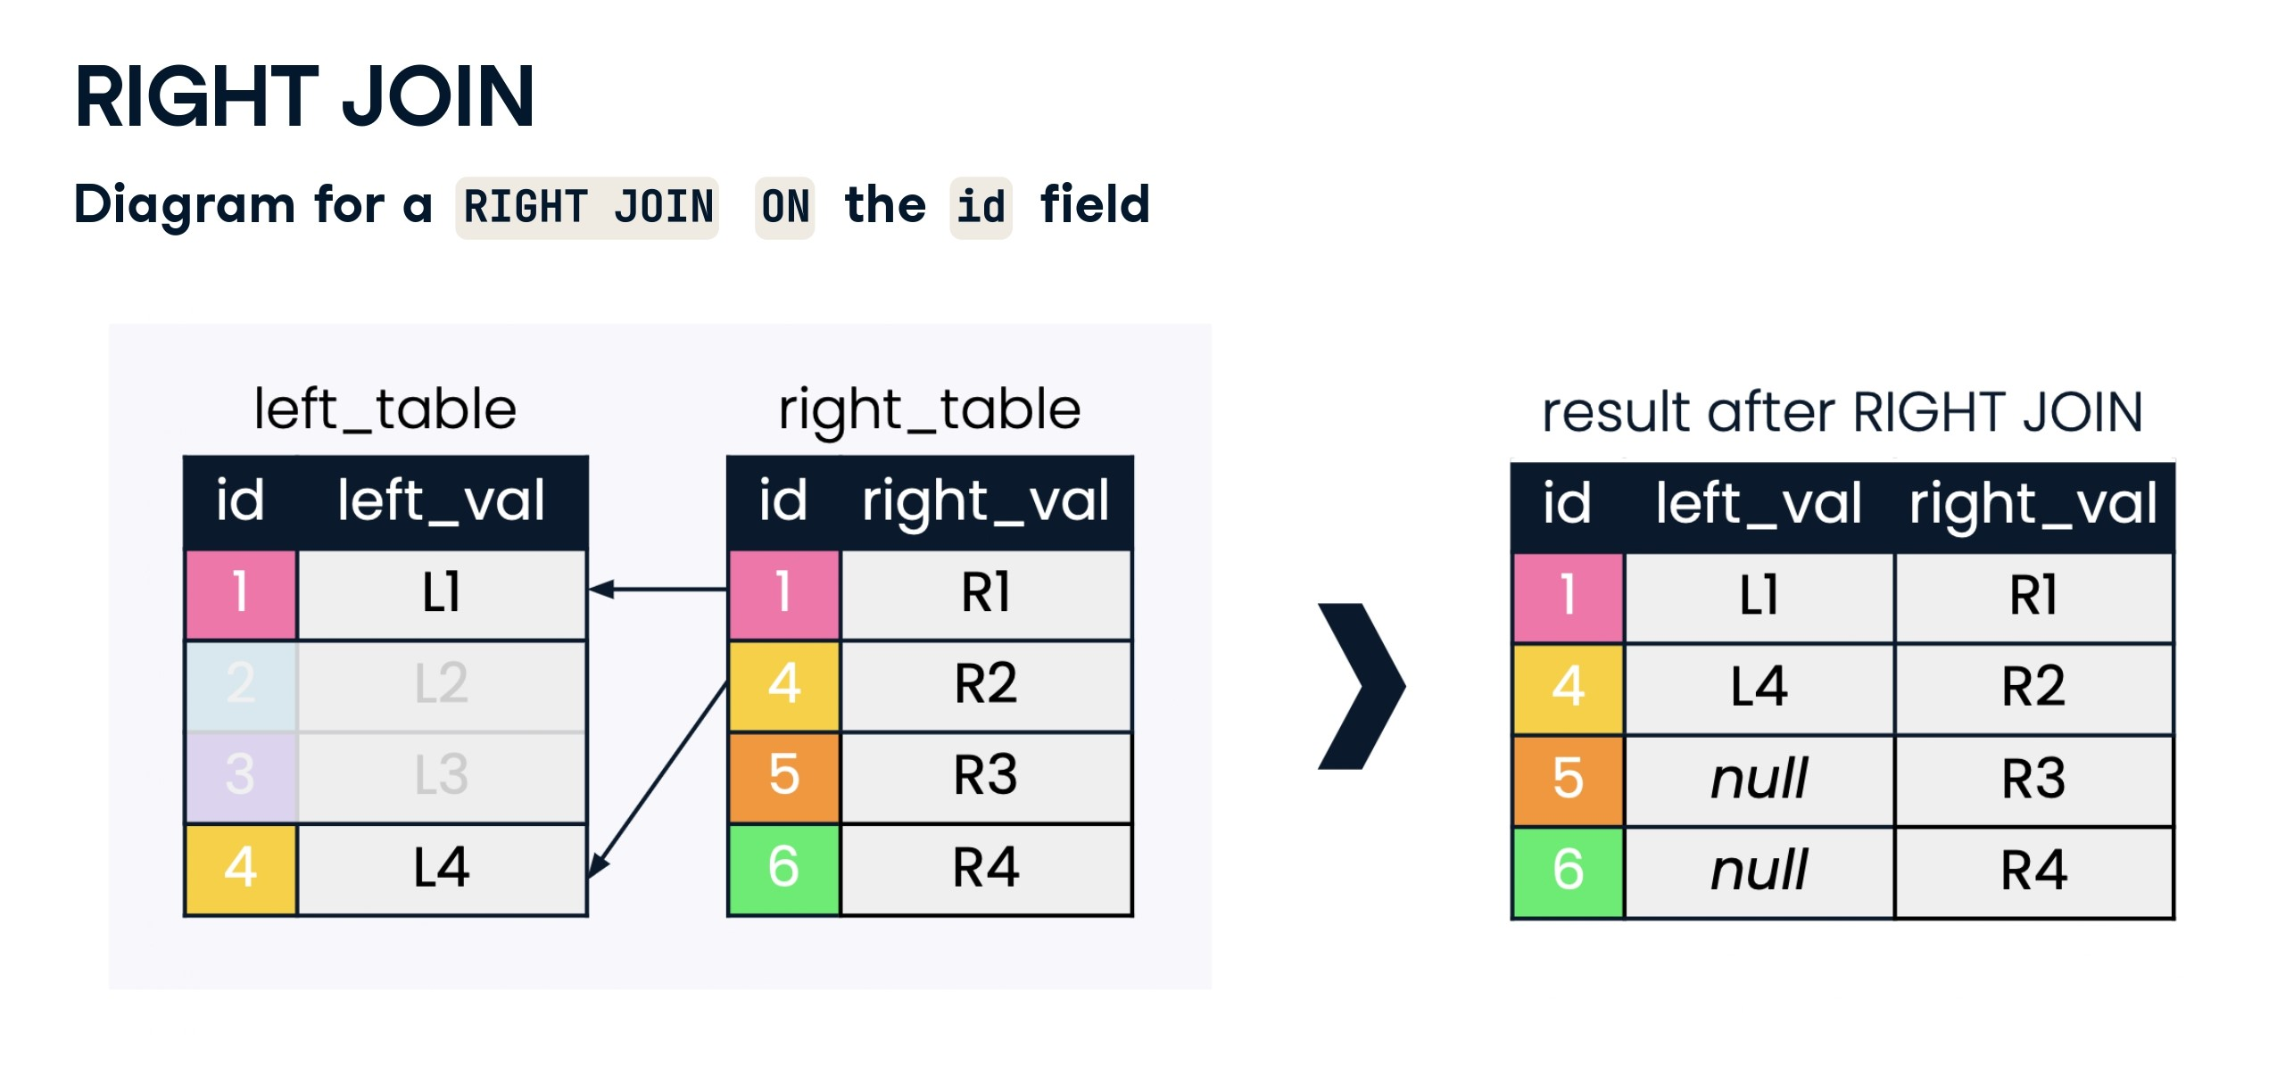

Slide 31
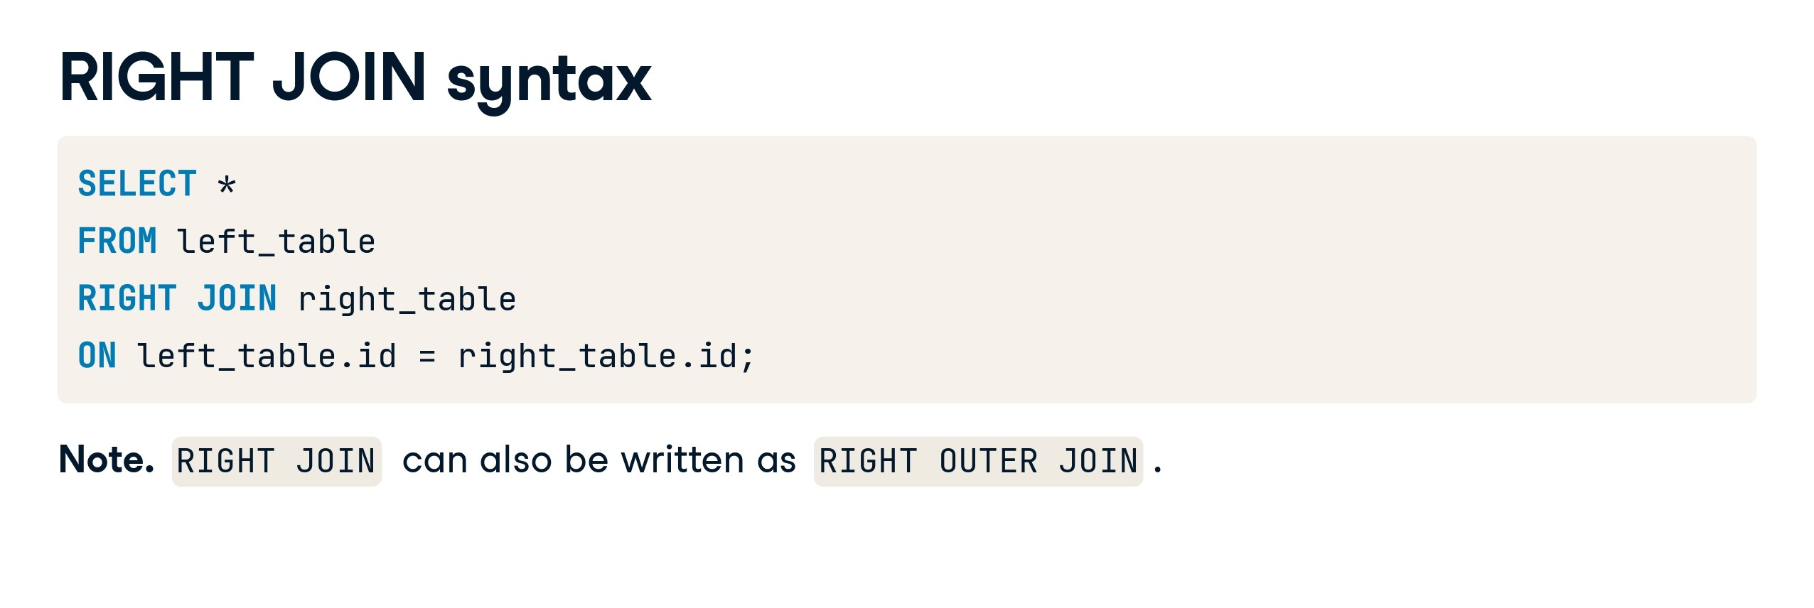

Slide 32
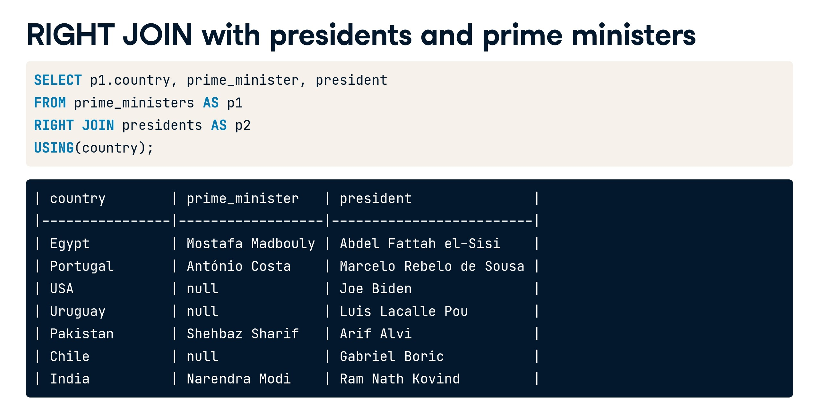

Slide 33
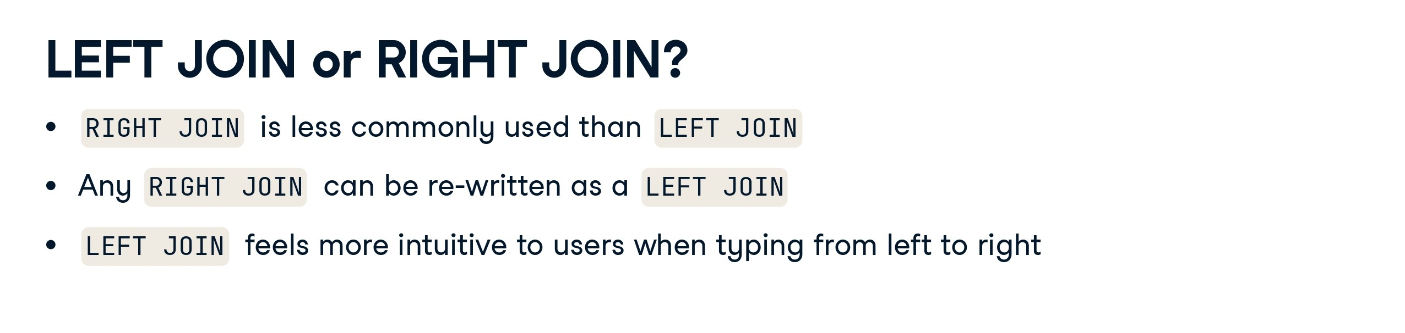

Slide 34


Slide 35


Slide 36
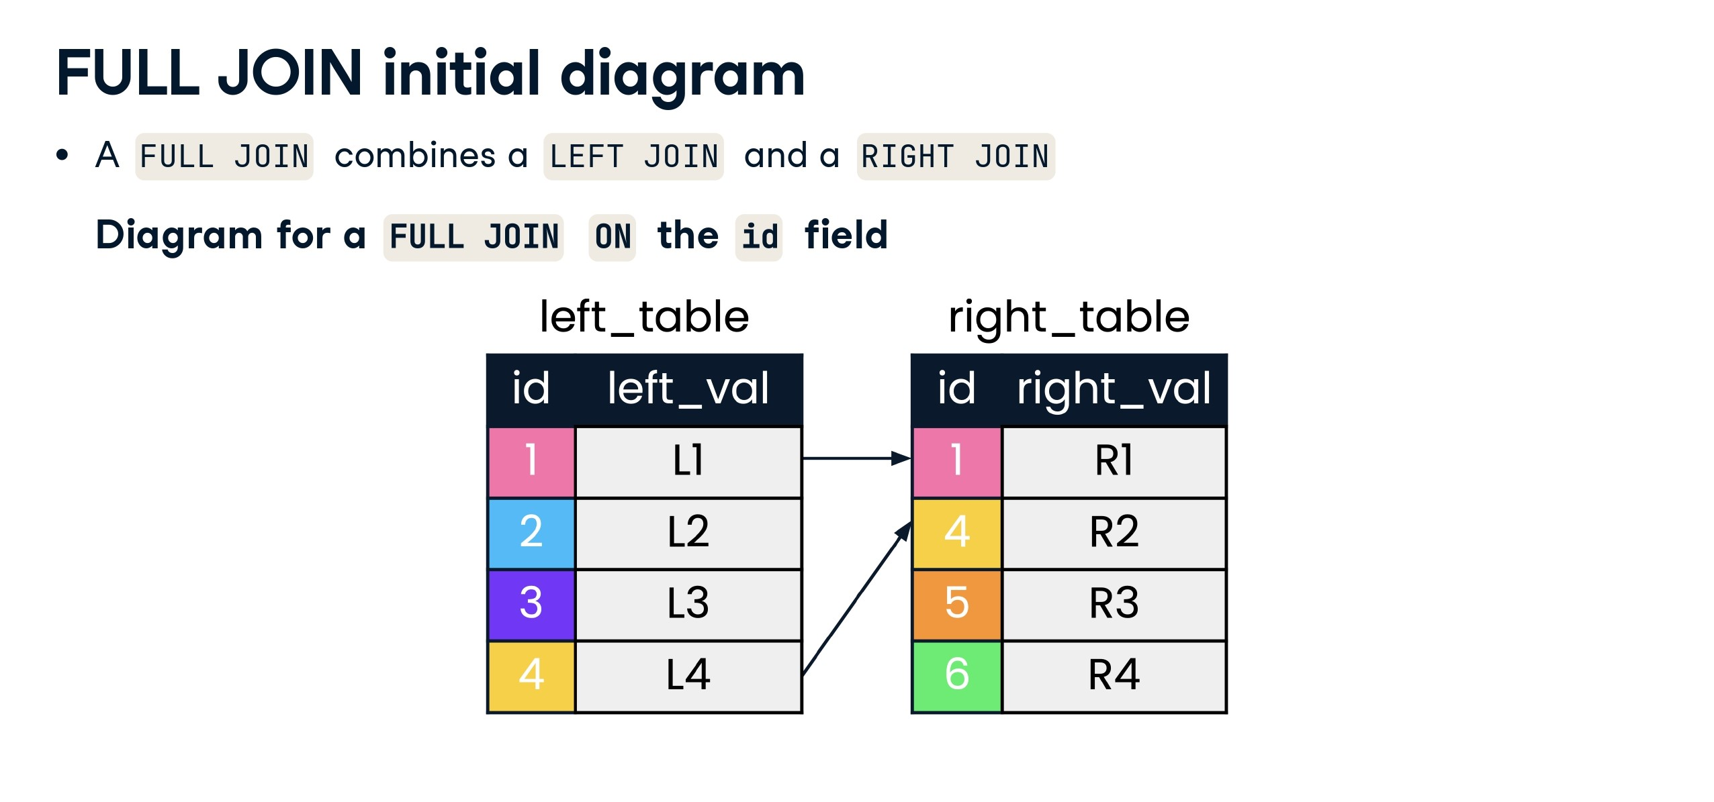

Slide 37
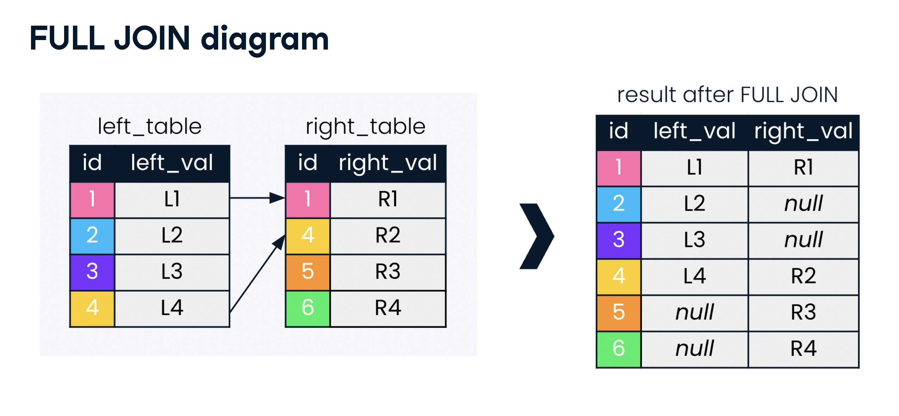

Slide 38
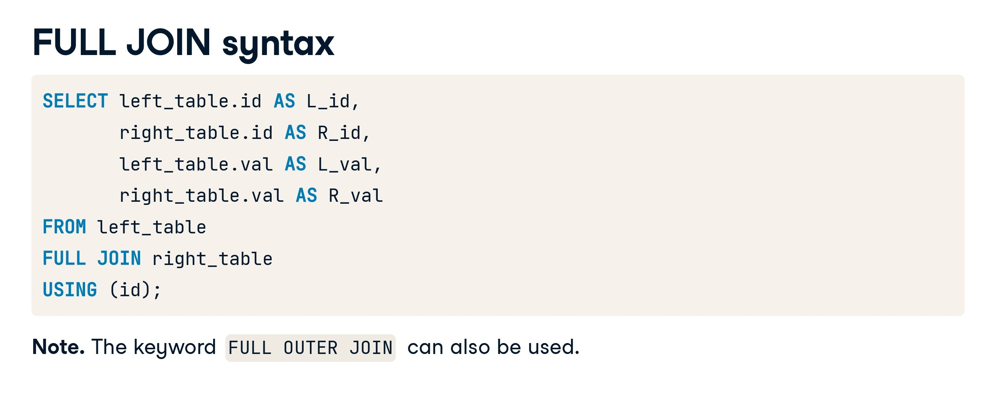

Slide 39
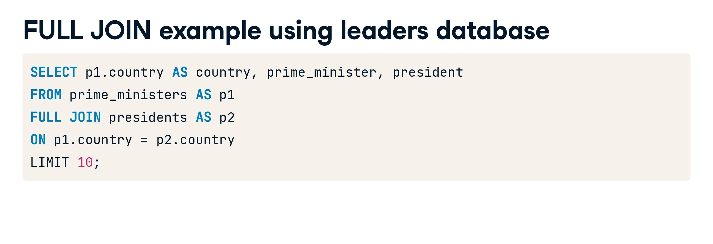

Slide 40
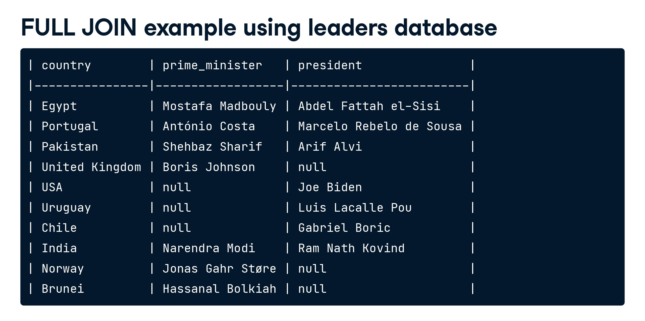

Slide 41


Slide 42


Slide 43
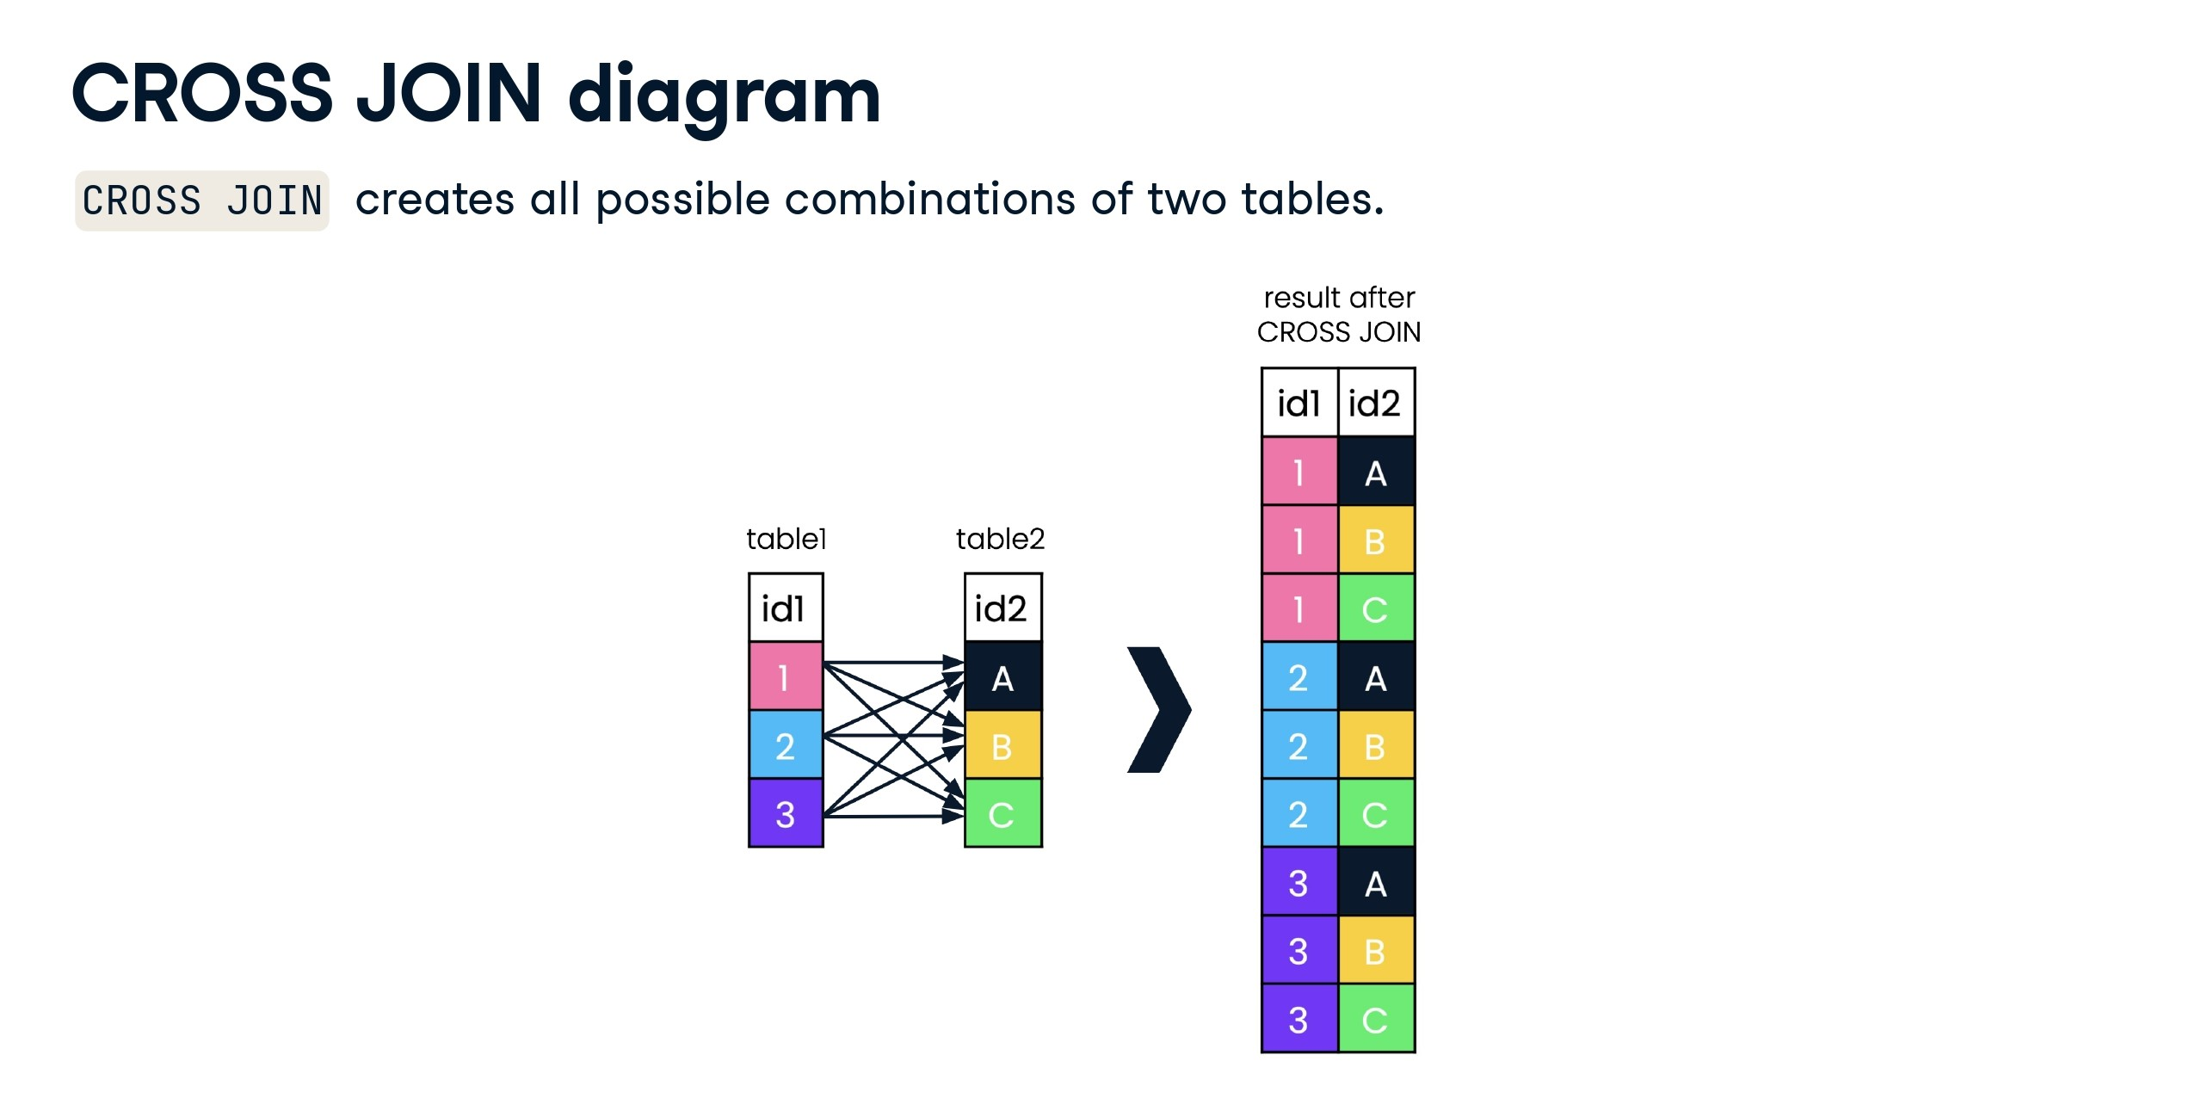

Slide 44
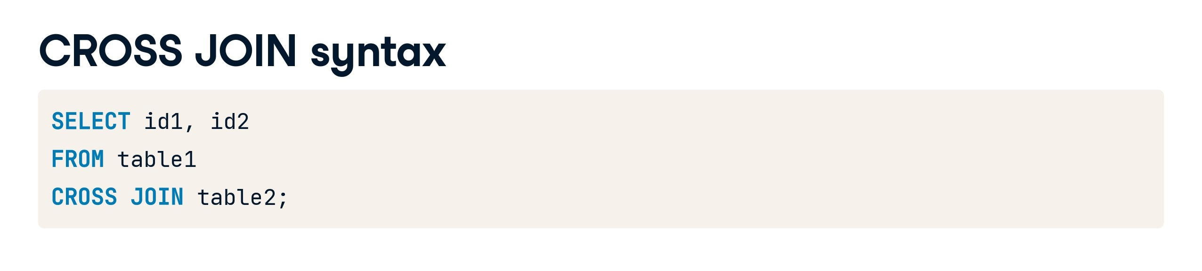

Slide 45
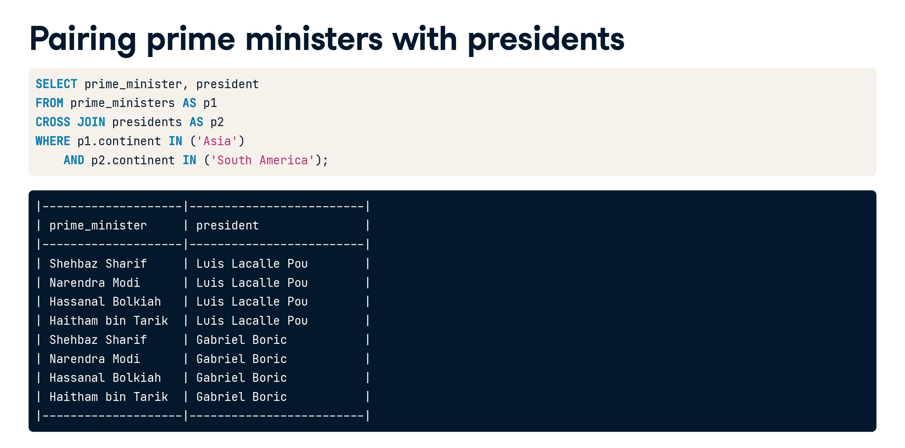

Slide 46


Slide 47


Slide 48
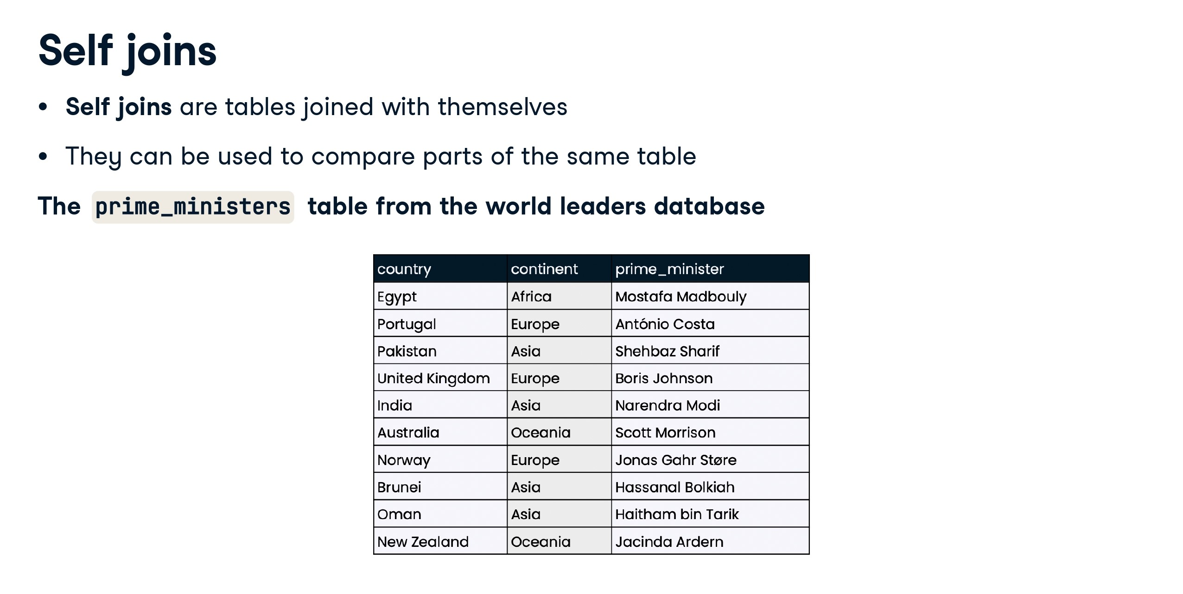

Slide 49
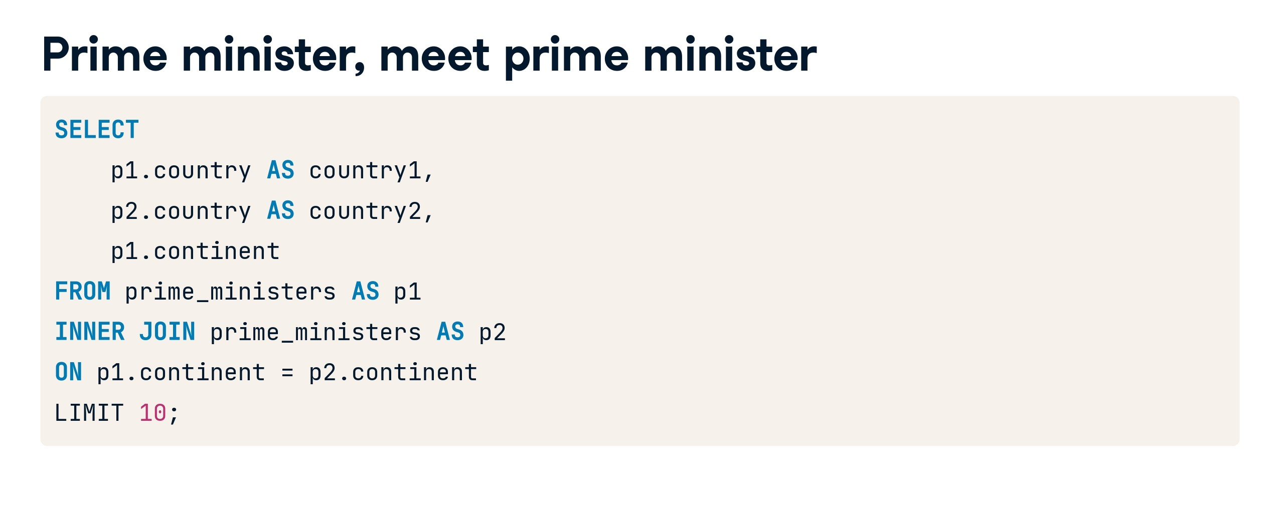

Slide 50
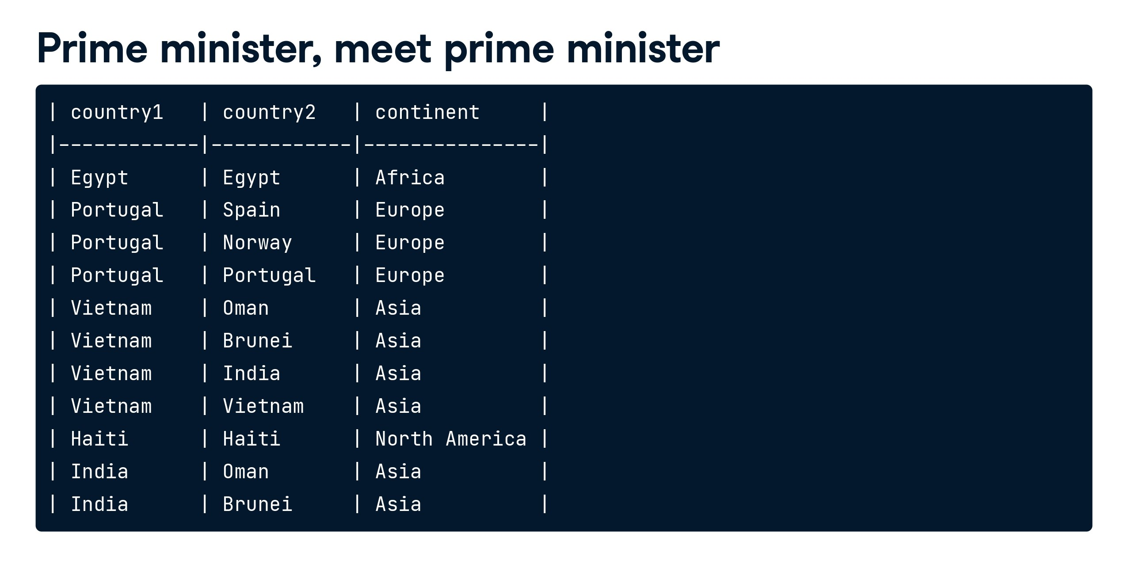

Slide 51
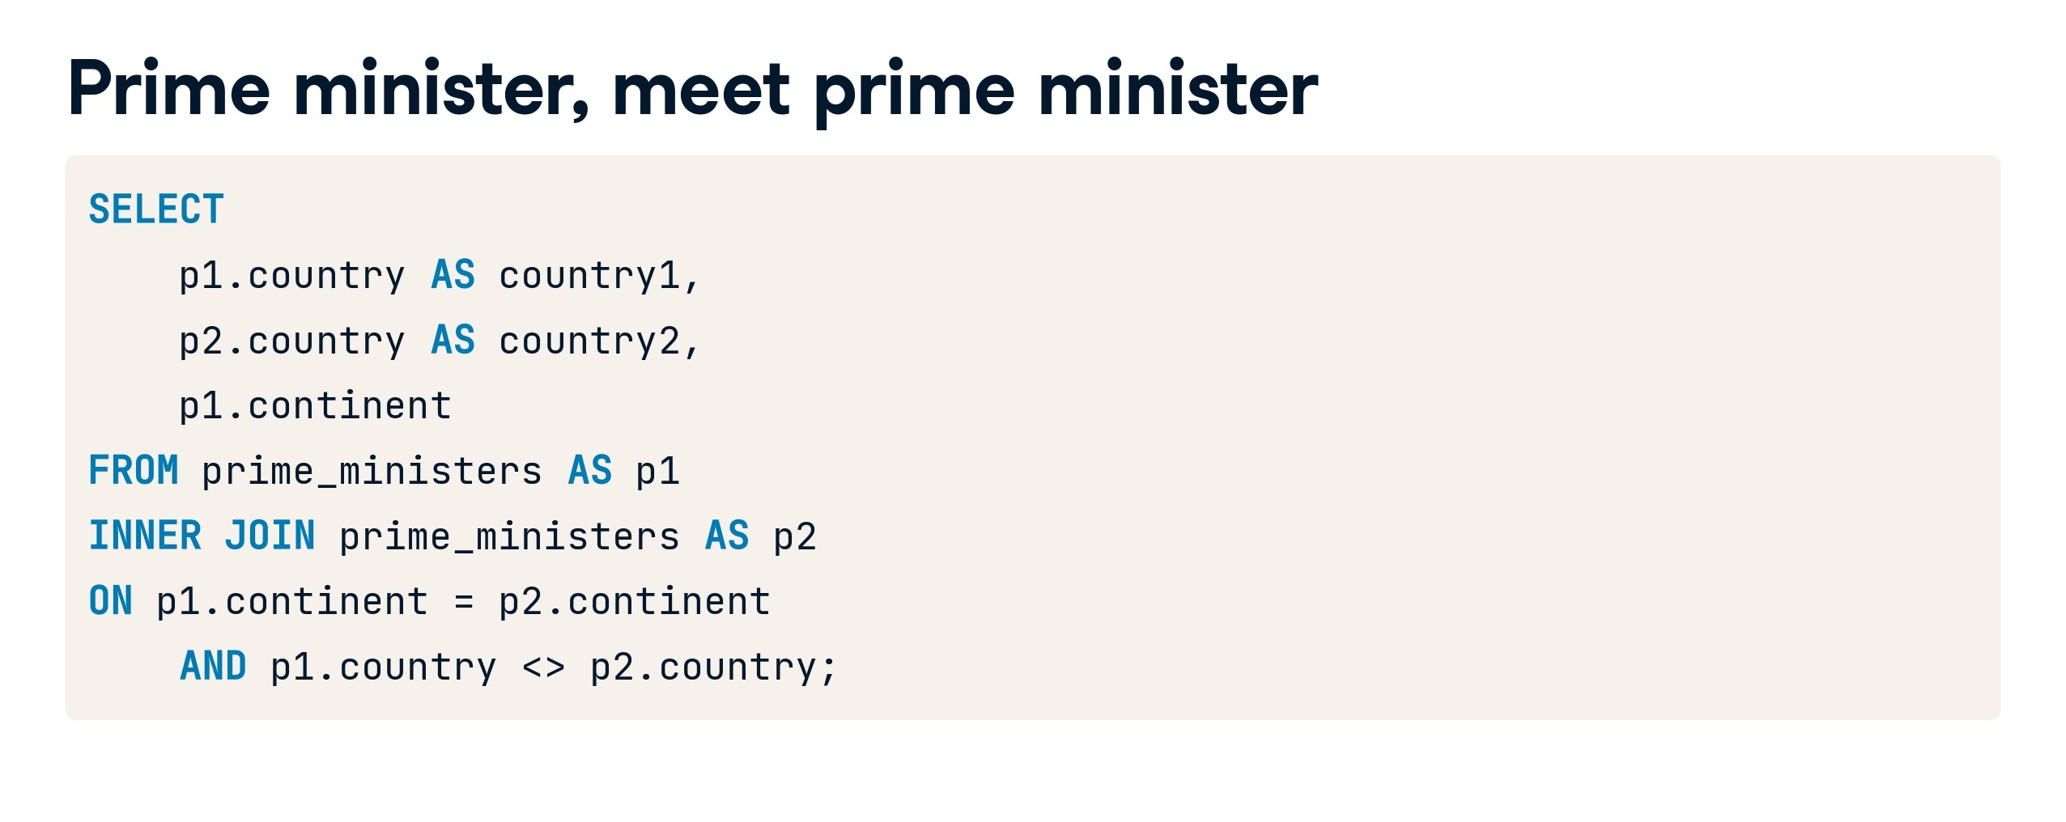

Slide 52
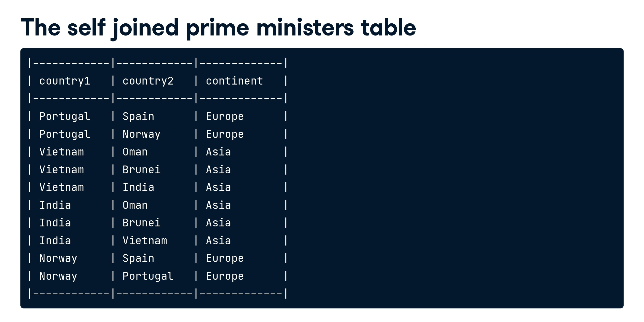

Slide 53
How many records will be there when we apply below joins. Comment down your answer in comment section below 1. inner join 2. left join 3. right join
Case Study 4:
Frequently Asked SQL Question
table A
=====
1
1
1
2
3
table B
=====
1
1
2
7
2

Slide 54
1. Inner join - 8 (intersection of both tables) 2. Left join - 8+1=9 ( intersection + unmatched records from left table) 3. Right join - 8+1 ( similar to left join)
Solution:
Frequently Asked SQL Question
table A
=====
1
1
1
2
3
table B
=====
1
1
2
7
2

Slide 55
Self Join:
-- Creating sample tables
CREATE TABLE Employees (
EmployeeID INT PRIMARY KEY,
FirstName NVARCHAR(50),
LastName NVARCHAR(50),
ManagerID INT -- ManagerID is a foreign key pointing to the EmployeeID of the manager
);
Case Study 5:
-- Inserting sample data into the Employees table
INSERT INTO Employees (EmployeeID, FirstName, LastName, ManagerID)
VALUES
(1, 'Rahul', 'Verma', NULL), -- Rahul Verma is the top-level manager (no manager)
(2, 'Priya', 'Sharma', 1), -- Priya Sharma reports to Rahul Verma
(3, 'Amit', 'Singh', 1), -- Amit Singh also reports to Rahul Verma
(4, 'Neha', 'Patel', 2), -- Neha Patel reports to Priya Sharma
(5, 'Vikas', 'Yadav', 2); -- Vikas Yadav also reports to Priya Sharma

Slide 56
Case Study 5 continue…:
-- Self Join Example: Retrieve employees along with their manager names
SELECT emp.FirstName AS EmployeeName,
emp.LastName AS EmployeeLastName,
mgr.FirstName AS ManagerName,
mgr.LastName AS ManagerLastName
FROM Employees emp
LEFT JOIN Employees mgr ON emp.ManagerID = mgr.EmployeeID;

Slide 57


Slide 58
End of Day 4
Any Query?

